Slide 1
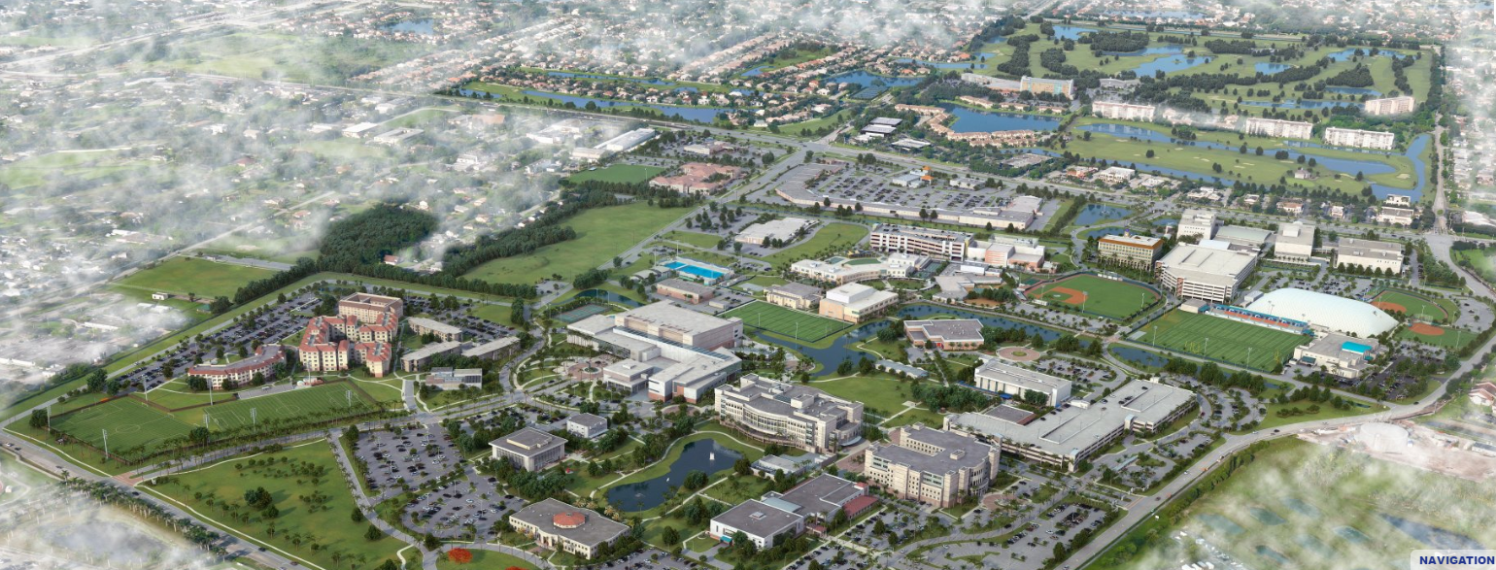
Nova Southeastern University (NSU) main Campus
Ft. Lauderdale Intl. Airport: 8.7 miles | Ft. Lauderdale Beach: 13.4 miles

Slide 2
Available Facilities
Rose and Alfred Miniaci Performing Arts Center
Huizenga Sales Institute (Room #3000)
Dr. William Spears Atrium (Room # 1062)
Knight Auditorium (Room #1124)
Huizenga Hall of Fame (Room #1014)
Classrooms

Slide 3
Huizenga Sales Institute
Dr. William Spears Atrium
Session- rooms
Huizenga Hall of Fame
Carl DeSantis Building

Slide 4
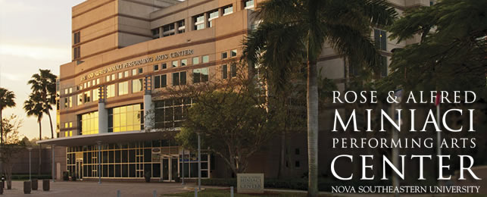
Rose and Alfred Miniaci Performing Arts Center
50 ft. across Carl DeSantis Building.
Walkable Distance from back door

Slide 5
Rose and Alfred Miniaci Performing Arts Center
State-of-the-art lighting and acoustics facility
500-seat auditorium
Part of Alvin Sherman Library
http://www.miniacipac.com/

Slide 6
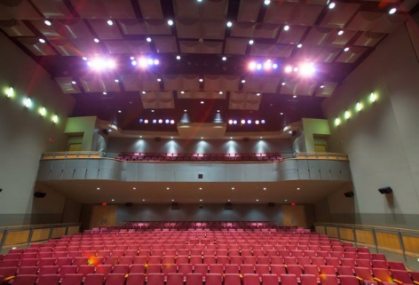
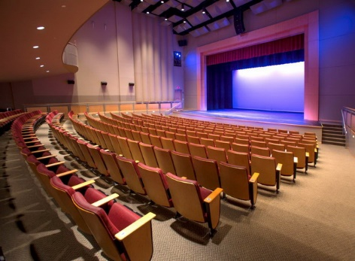
Rose and Alfred Miniaci Performing Arts Center

Slide 7
Huizenga Sales Institute (Room #3000)
8200 sq ft. facility, part of Huizenga College of Business
Excellent location for seminars, conferences, presentations, etc.

Slide 8
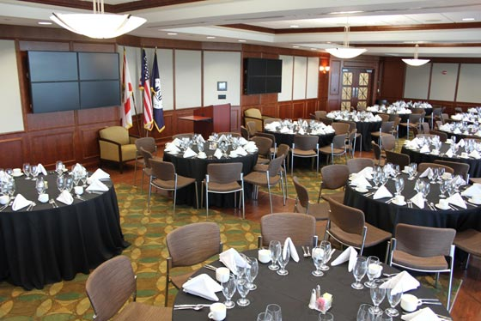
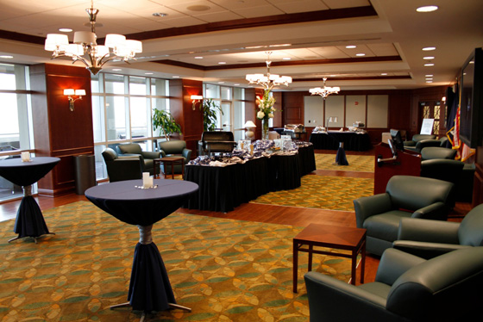
Huizenga Sales Institute (Room #3000)
Capacity: 265
Use: Reception

Slide 9
Dr. William Spears Atrium (Room #1062)
Location DeSantis Building

Slide 10
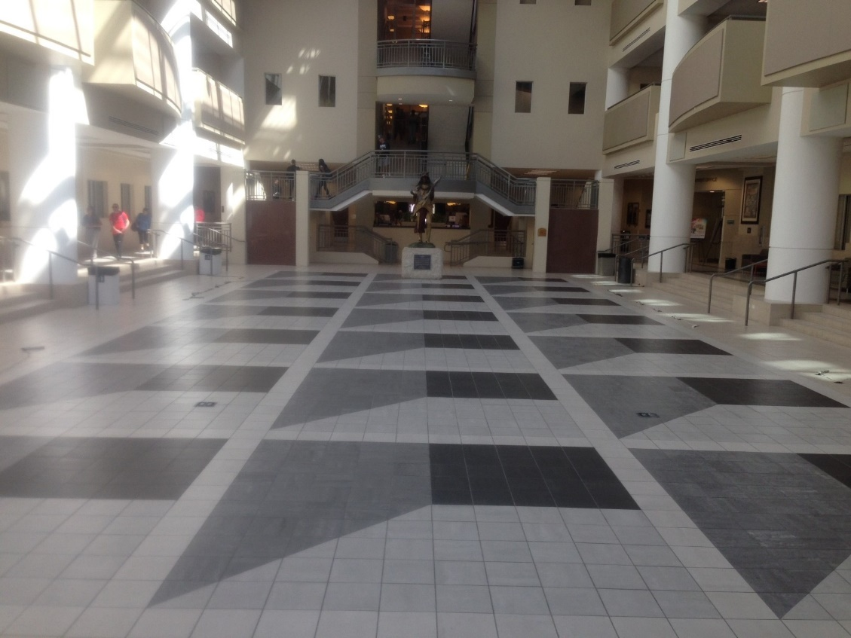
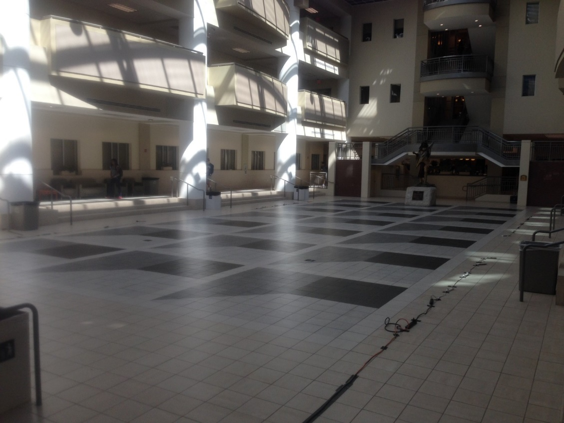
Dr. William Spears Atrium (Room #1062)
Capacity: 365
Use: Lunch/ Break

Slide 11
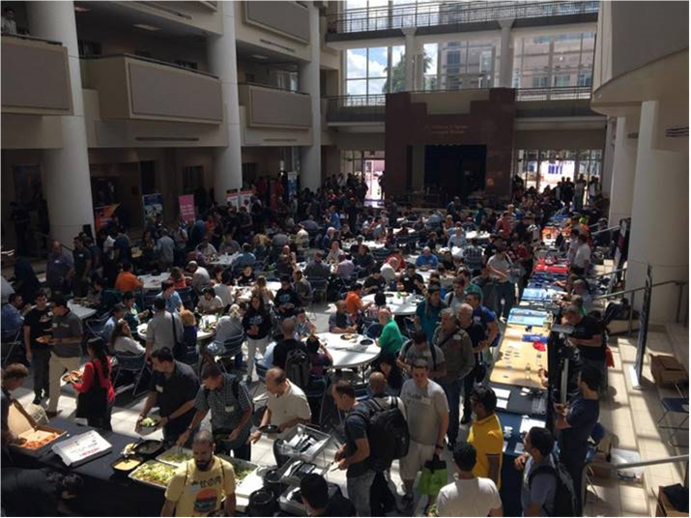
Dr. William Spears Atrium (Room #1062)
Atrium during an Event

Slide 12
Huizenga Hall of Fame (Room #1014)
Location: DeSantis Building

Slide 13
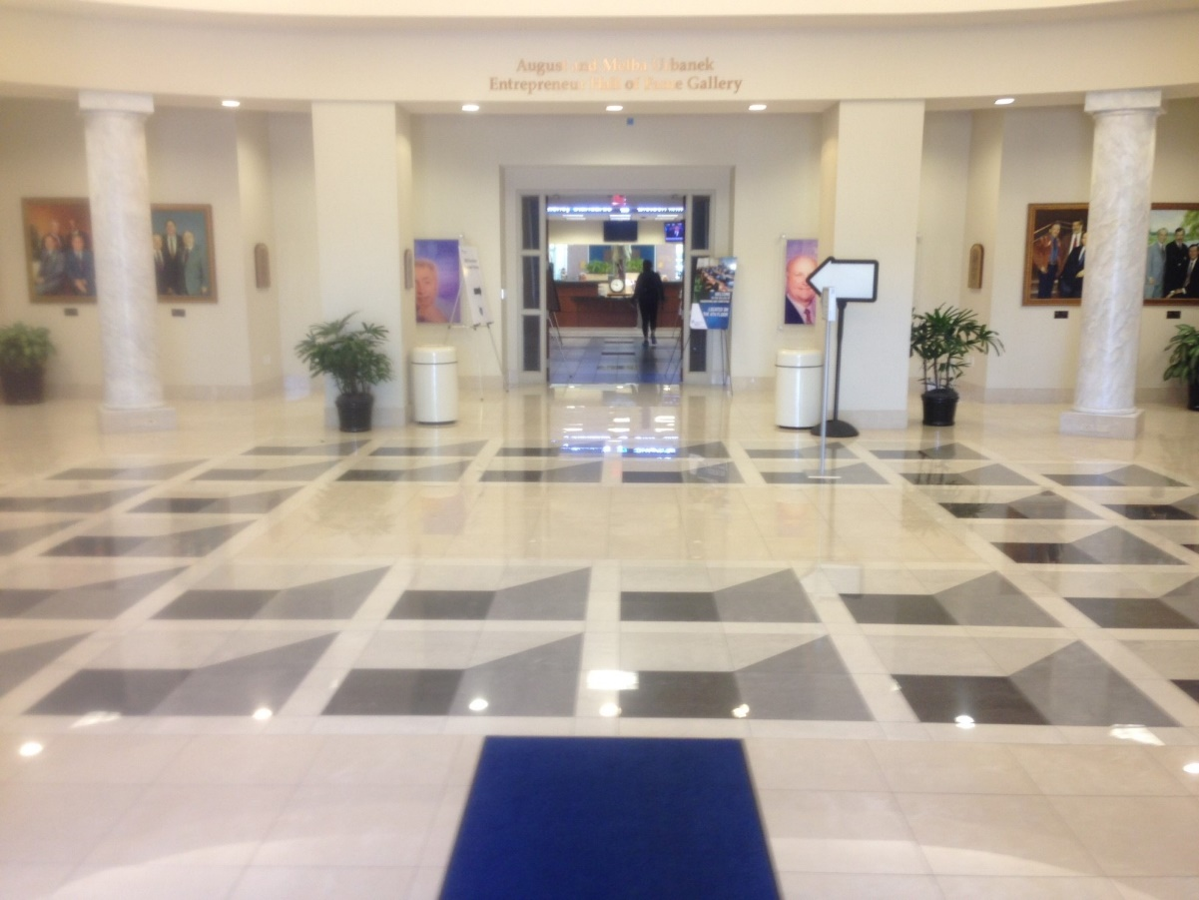
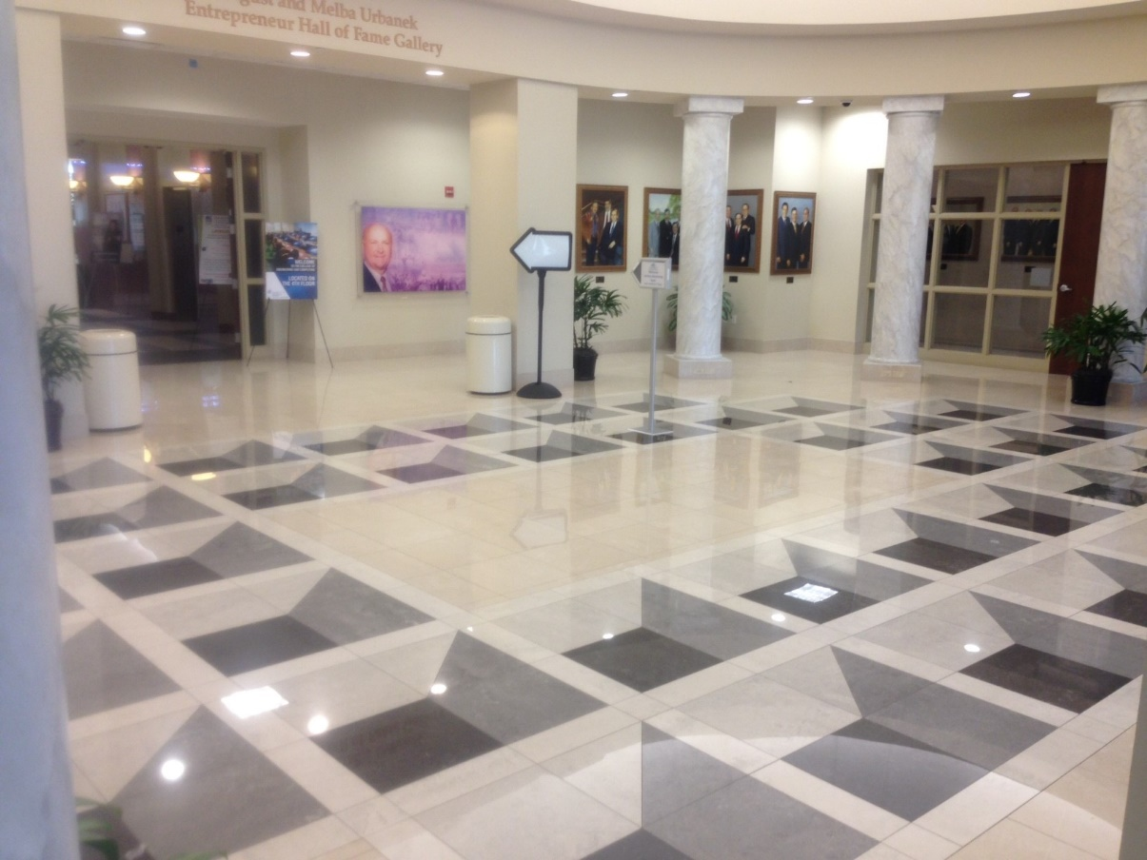
Huizenga Hall of Fame (Room #1014)
Capacity: 150
Use: Registration/ Check-in

Slide 14
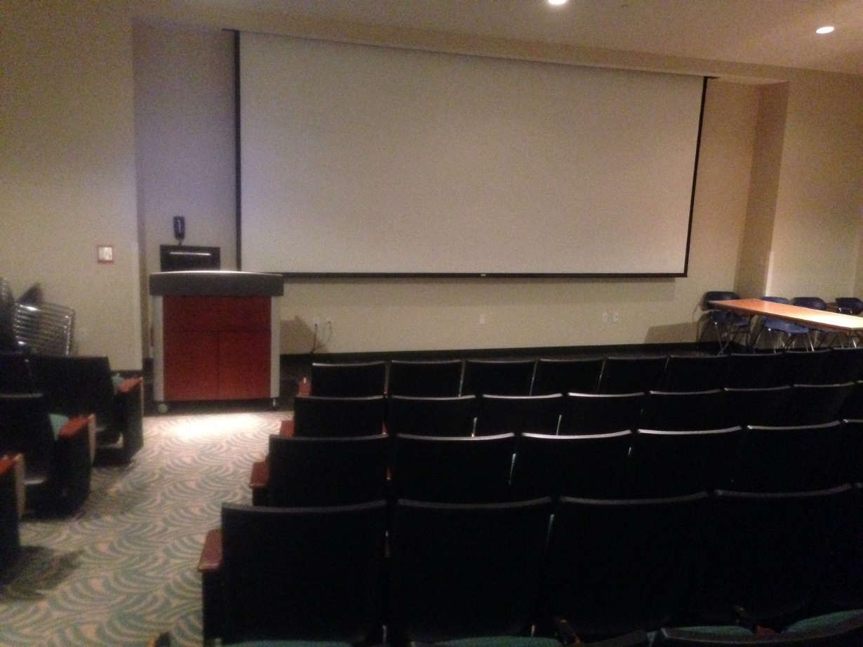
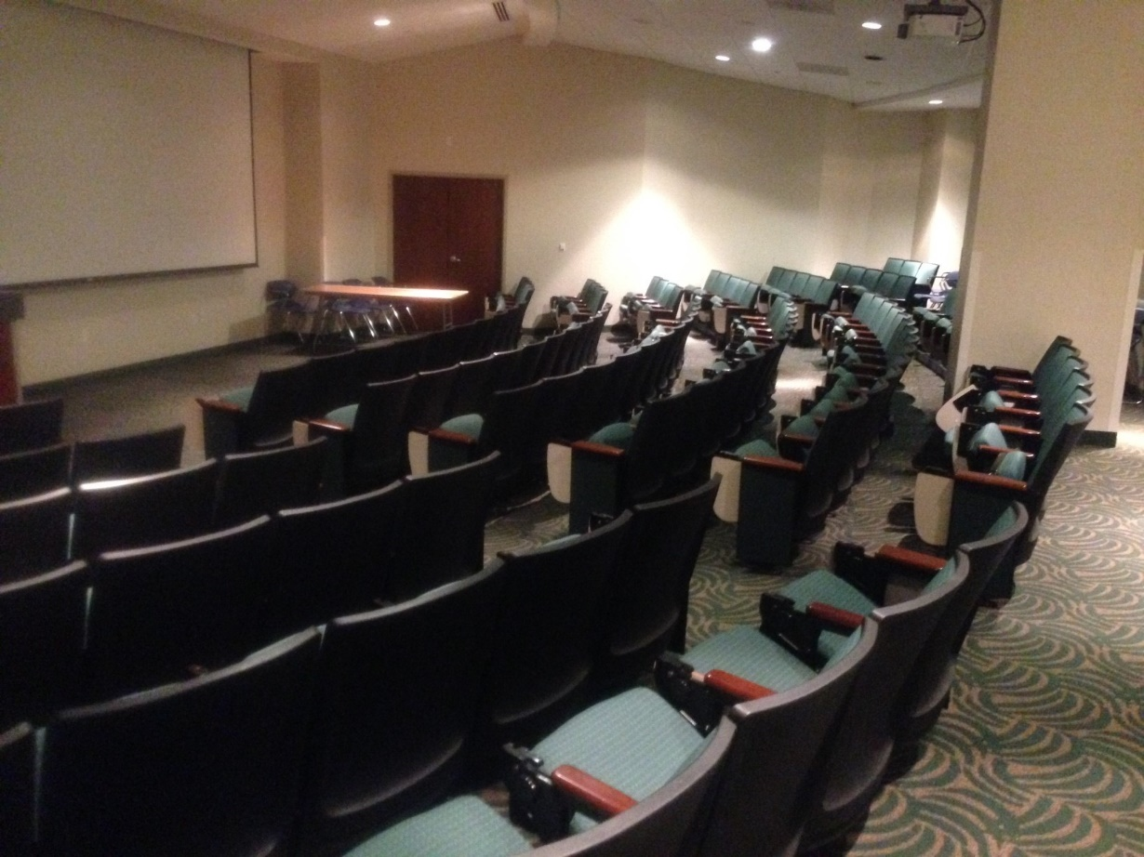
Knight Auditorium (Room #1124)
Capacity: 133

Slide 15
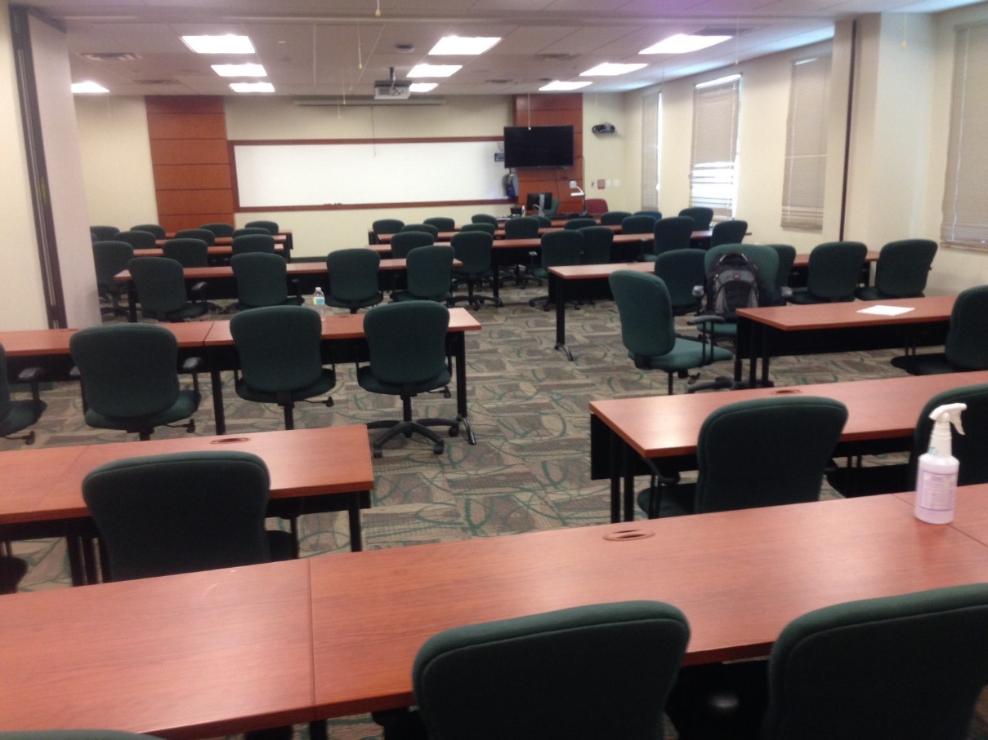
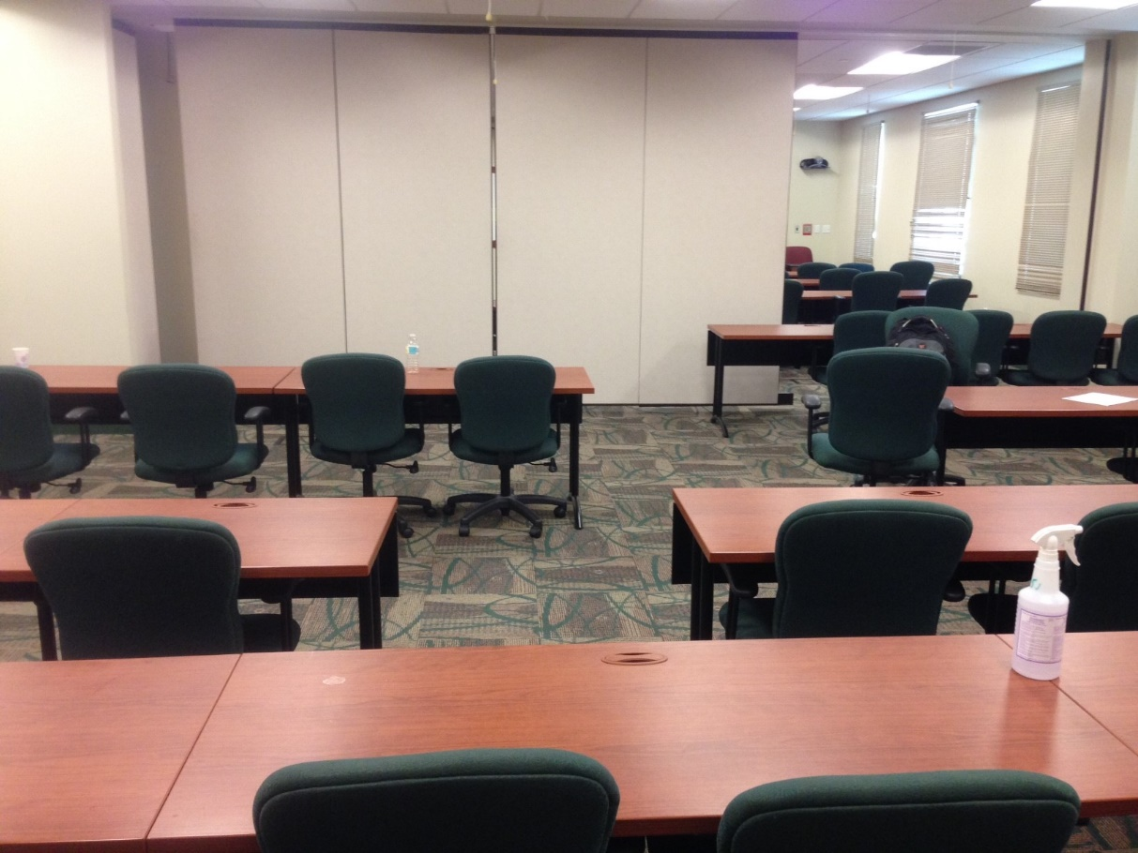
Session- rooms
Without partition.
Capacity: 80
With partition.
Capacity: 40
Classrooms | 1048/1049 1053/1054 3032/3034 3049/3051
Classrooms | 1047/ 1052 1133/3030 3130/3033

Slide 16
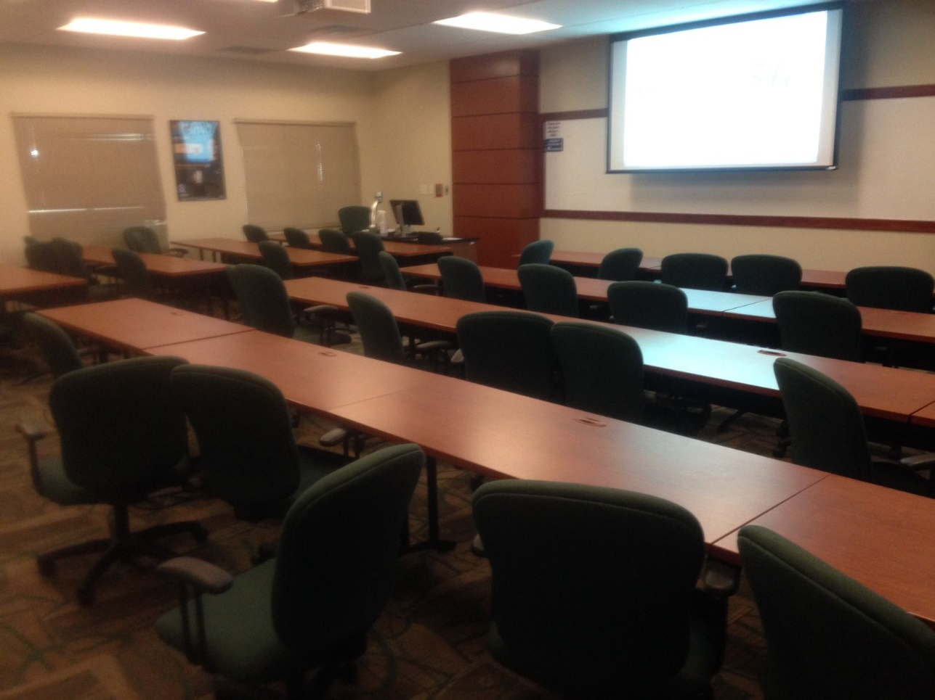
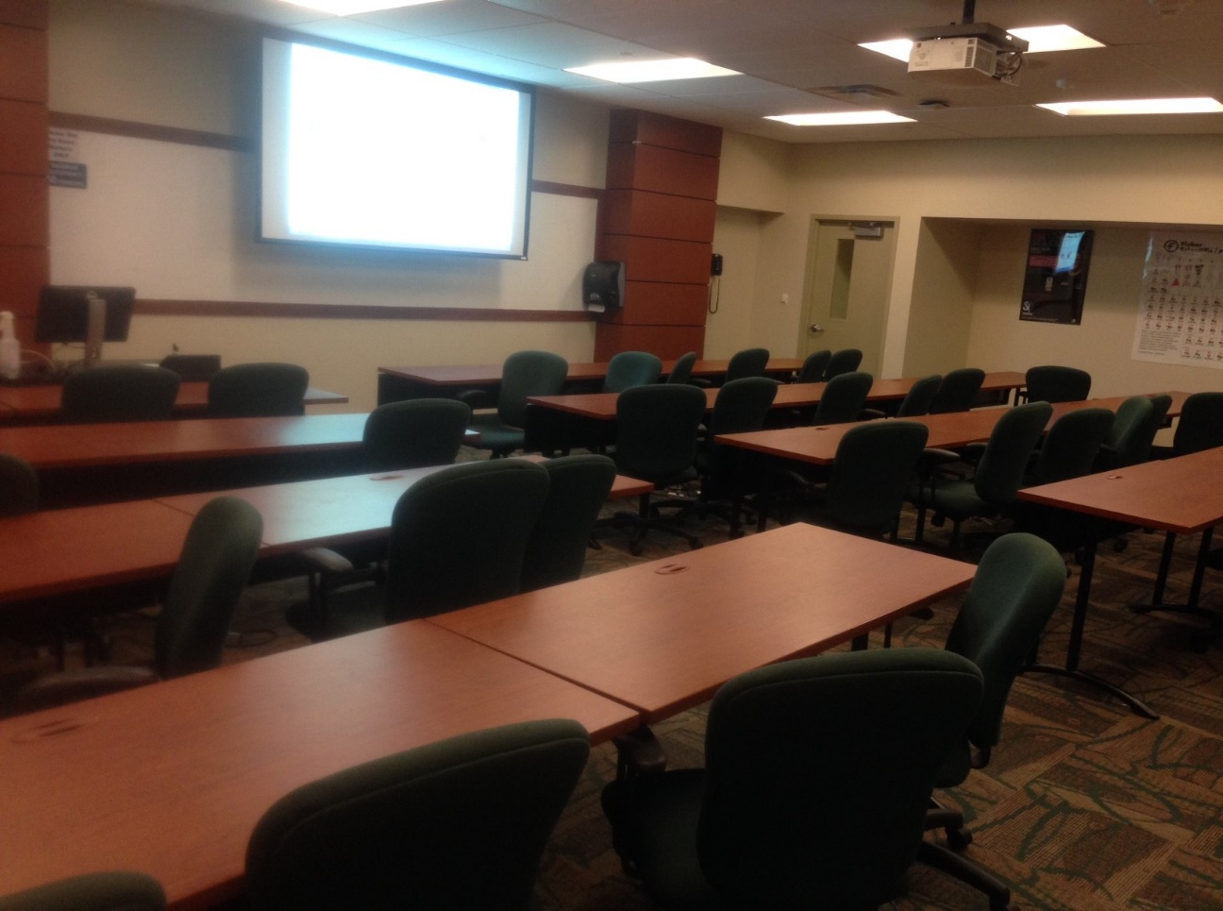
Session- rooms

Slide 17
Thank you!
We hope to see you soon…..

